Slide 1
ES 2015
AKA ECMAScript 6
AKA ECMAScript “Harmony”

Slide 2
I can’t make presentations
Most of this talk was based on the book:
Learning ECMAScript 6, Narayan Prusty, Packt Pub
A lot of stuff was stolen from:
The amazing ES6 page of the Mozilla Developer Network
And a lot of other sources with links in each slide
Notes:
The next slides are mostly based on the amazing book Learning ECMAScript 6 by Narayan Prusty, which explains in depth most of the new features of ES2015. Other code examples or text excerpts have the respective sources on the bottom-right corner of each slide.

Slide 3
ECMAScript versions
ES1 - 1997
ES2 - 1998
ES3 - 1999
ES4 - RIP
ES5 - 2009
ES5.1 - 2011
ES2015 - 2015 (6th edition – you decide the name)
ES2016 – 2016? (AKA ECMAScript 7 AKA JS.next)
Source: Wikipedia
Notes:
ECMAScript, the language standard that defines JavaScript, has come a long way since it was invented by Brenden Eich in 1997. Most of the code we use today is based on ES3 and ES5 since ES4 failed to succeed with its too many innovations for the time. ES6 (formally known as ES2015) grabbed some of those discarded features and created a new standard for a lot other non-standard features we’ve been using for the past time.

Slide 4
Where can you use ES 2015? (April 2016)
ES 2015
Chrome 49 – 90% features
Firefox 45– 85%
Edge 13 – 79%
Babel – 74%
TypeScript – 60%
Traceur – 58%
Node 5 – 56%
Safari 9 – 53%
TRANSPILER
ES 5
Source: Kangax
Notes:
Since we don’t want to lose users by evolving the language we use, it is recommended to transpilers (such as Babel) transform ES6 code in ES5.

Slide 5
What’s new
Syntax
Libraries
Iterators
Promises
Classes
Modules
Advanced
Advanced
Out of scope
Reflect API
Proxies

Slide 6
What’s new
Syntax
Notes:
Let’s start by talking a bit about syntax and what can we now do easily instead of using ugly hacks.

Slide 7
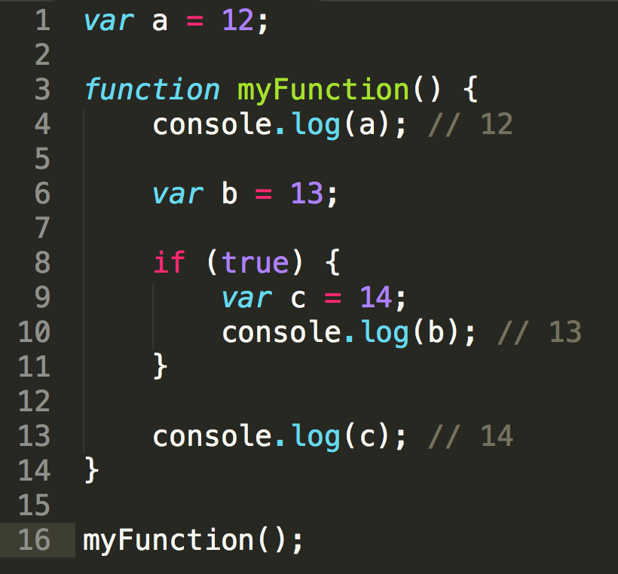
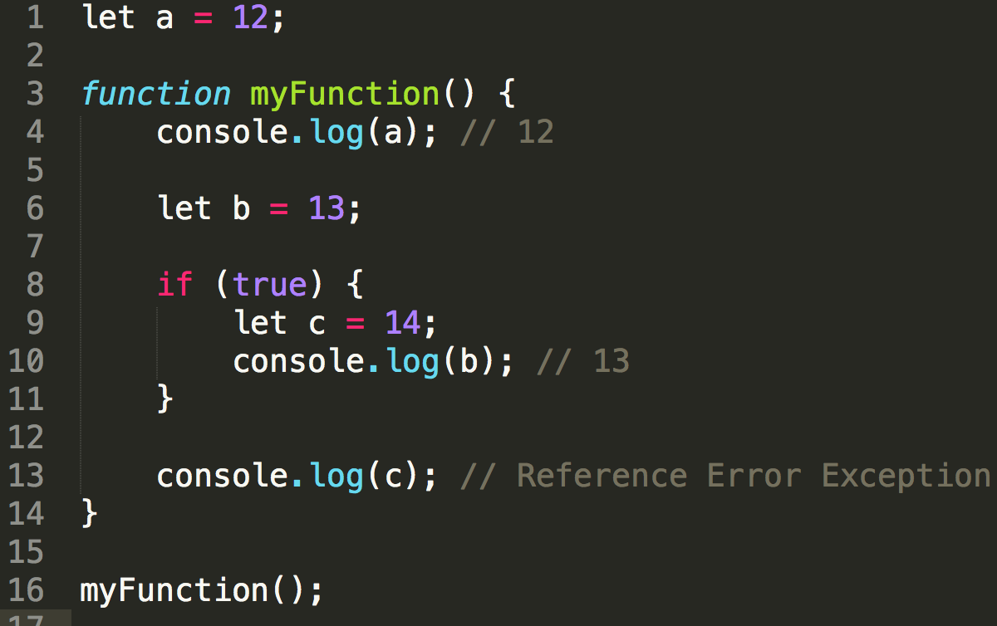
Syntax – let keyword
Notes:
The let keyword is ES6’s way of correcting that awful bug called function scope. By providing us block scope instead, we can cleanly define variables inside blocks such as if clauses without making them available to the whole function. My personal recommendation is that you never use the var keyword again.

Slide 8
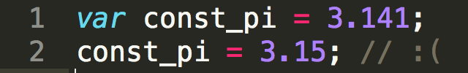
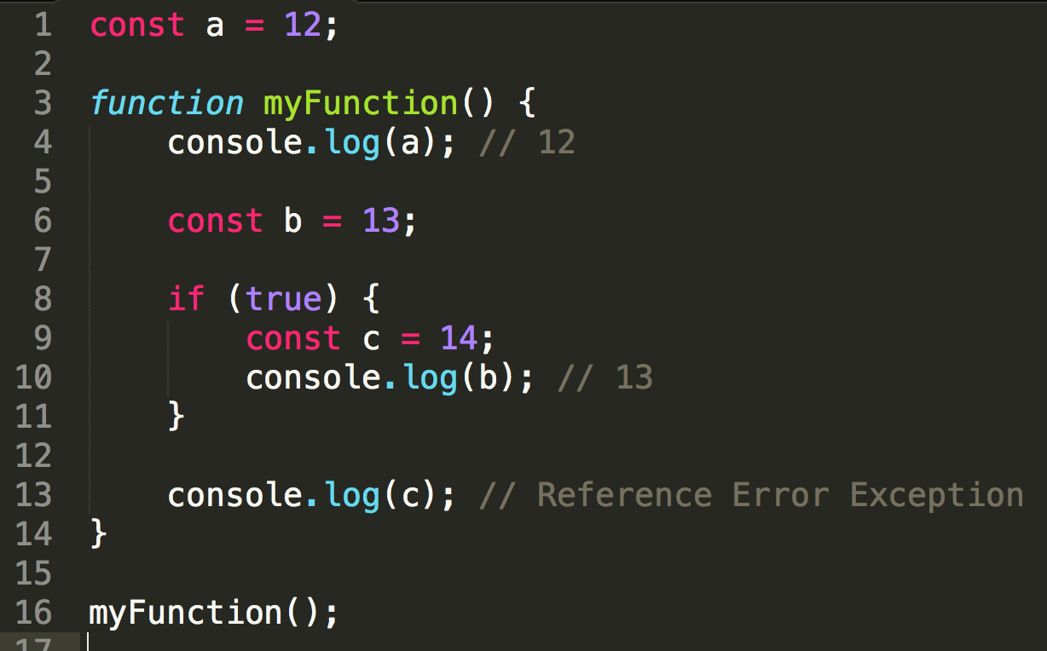
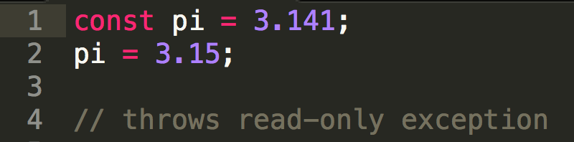
Syntax – const keyword
Notes:
Long gone are the days you needed to prefix your variables with ‘const’ or make name them all CAPS. Start using the const keyword for your constants and avoid mutation the right way.

Slide 9
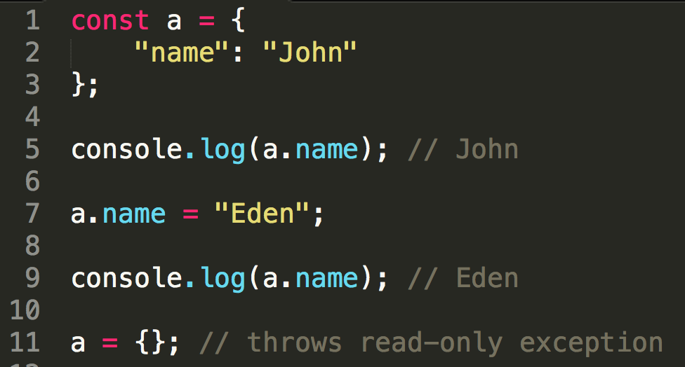
Syntax – const keyword
constant !== immutable
Notes:
But please beware that when you define an object as a constant it does not make the object immutable. You can still change the object properties.

Slide 10
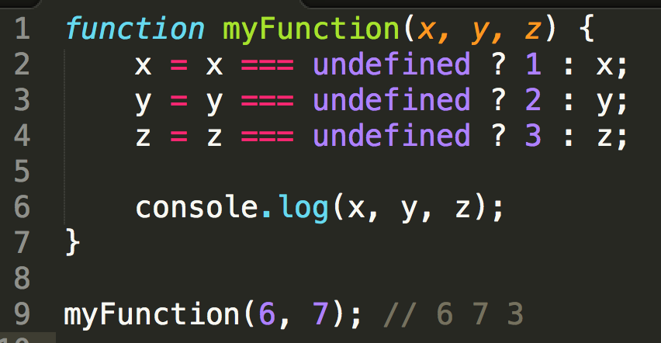
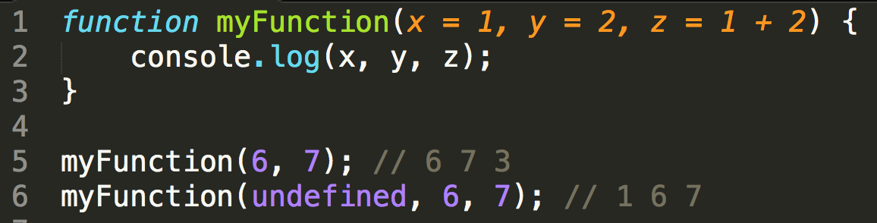
Syntax – default parameters
Notes:
Default parameters have always been one of the most needed features in JavaScript. Now you can directly assign them in the function declaration and make your code a lot cleaner.

Slide 11
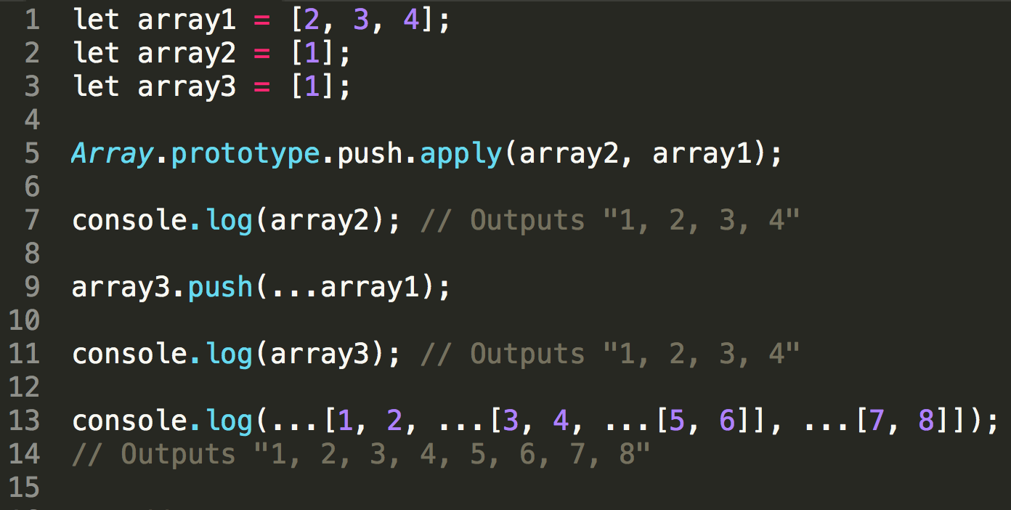
Syntax – spread operator…
Notes:
The idea behind the spread operator is very simple – to spread the values of an iterable (we’ll talk about that later) for multiple usages. E.g. calling a function or building another iterable such as an array.

Slide 12
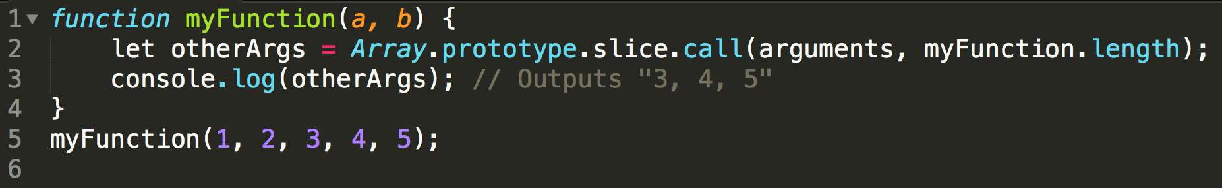
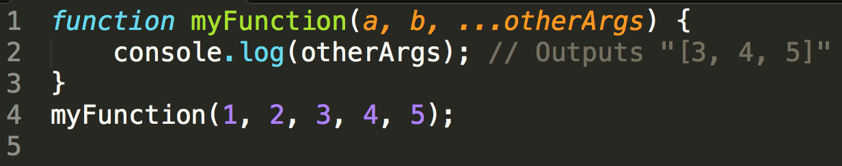
Syntax – rest parameter…
Notes:
Looking a lot like the spread operator, the rest parameter is a much cleaner way to get all the parameters that come after the declared ones. Again, a lot less hacky.

Slide 13
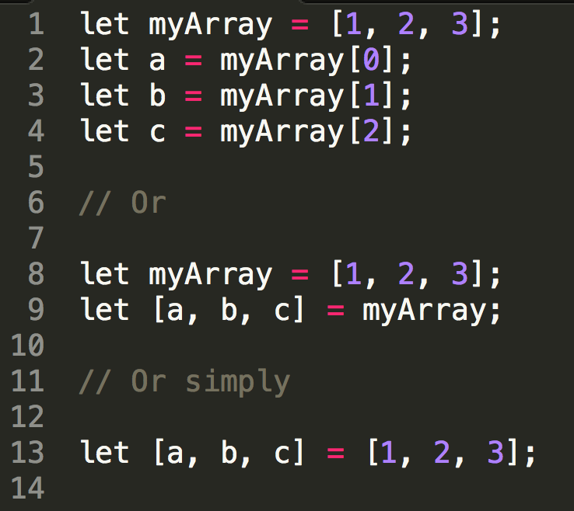
Syntax – array destructuring assignment
Notes:
Destructuring assignments are a new syntax feature that allows you an easy way of assigning properties to variables. Here we can see how to do that with an array and in a single line instead of at least 4.

Slide 14
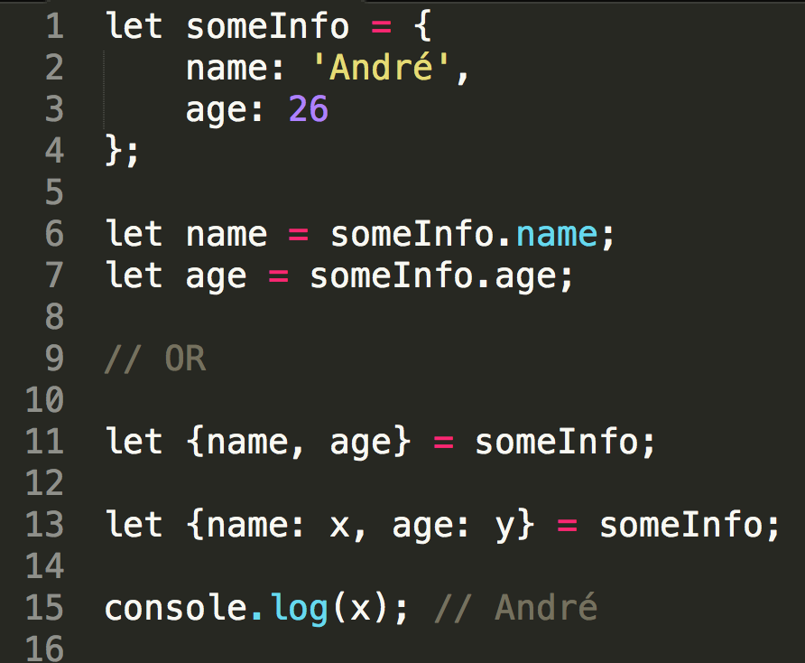
Syntax – object destructuring assignment
Notes:
With the same concept but applied to objects, if you ever coded JavaScript, I’m sure you had to assign

Slide 15
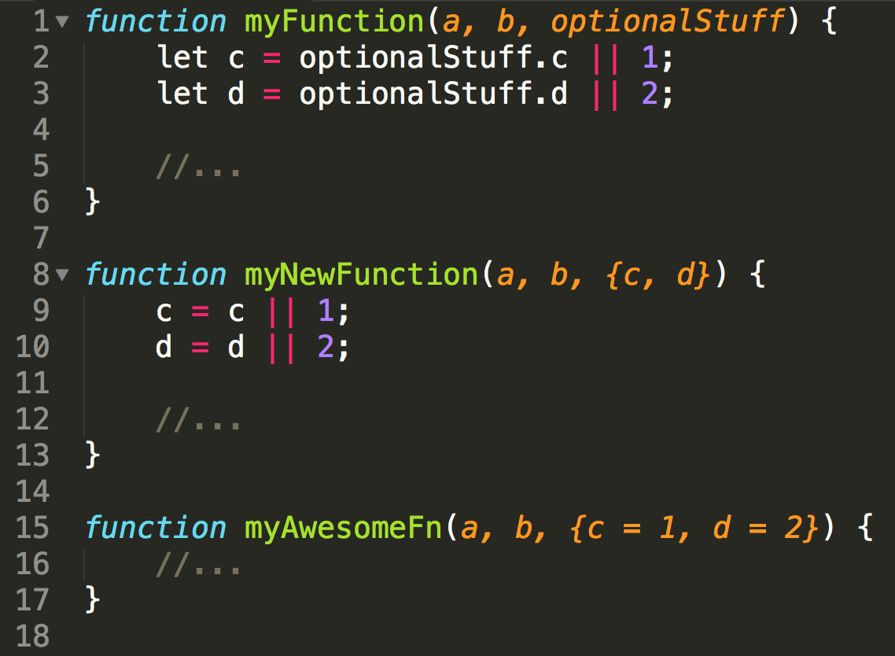
Syntax – object destructuring assignment

Slide 16
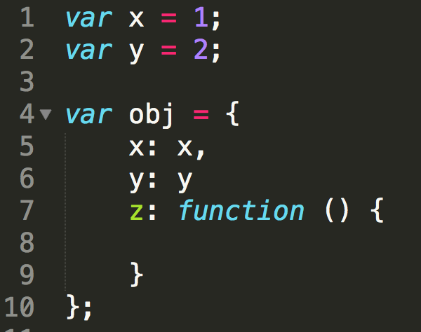
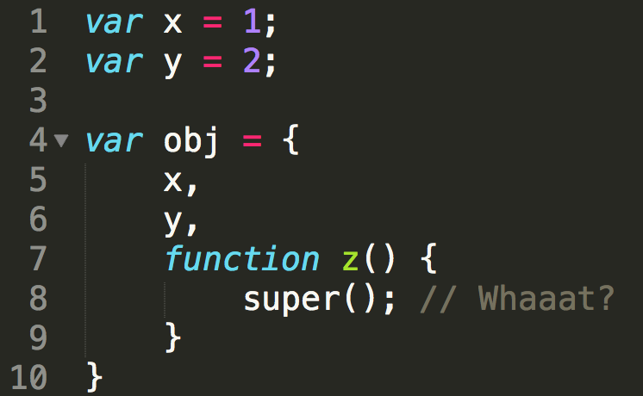
Syntax – enhanced object literals

Slide 17
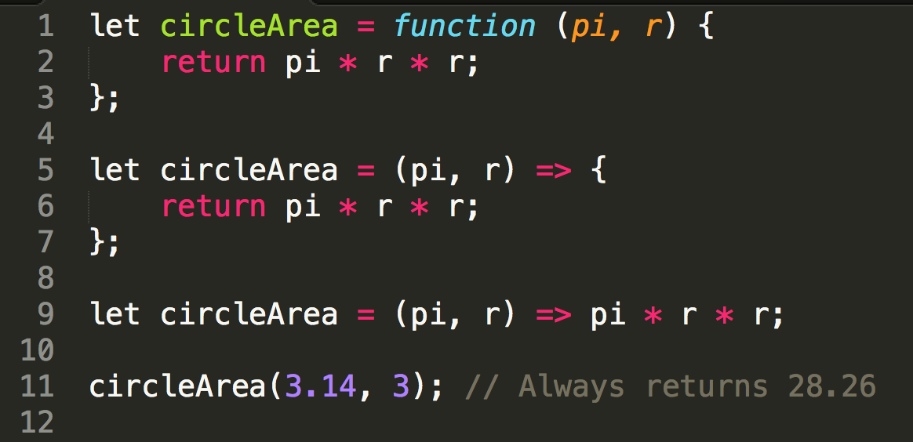
Syntax – arrow functions

Slide 18
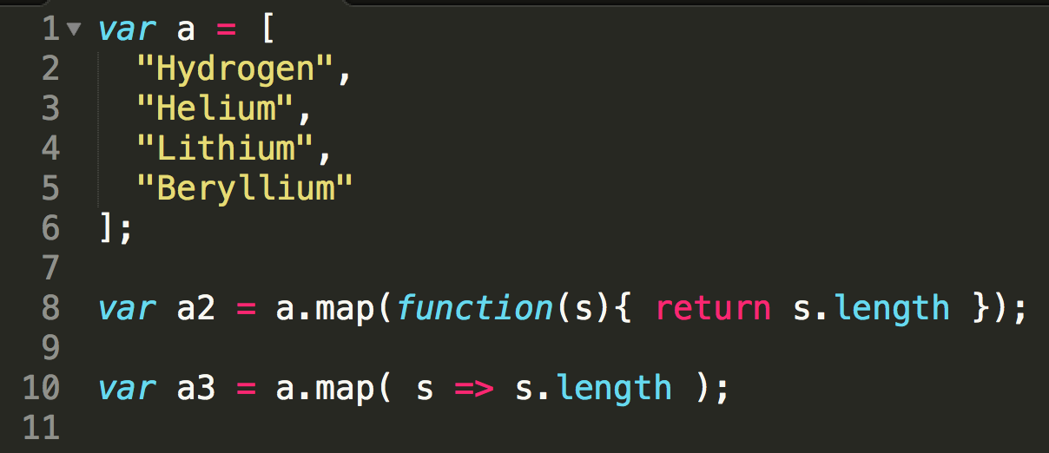
Syntax – arrow functions
Source: MDN

Slide 19
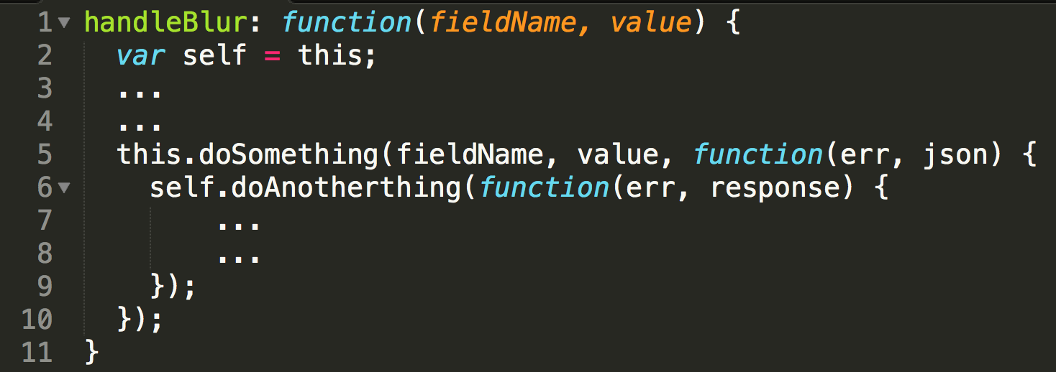
Syntax – arrow functions (this)
Source: alicoding

Slide 20
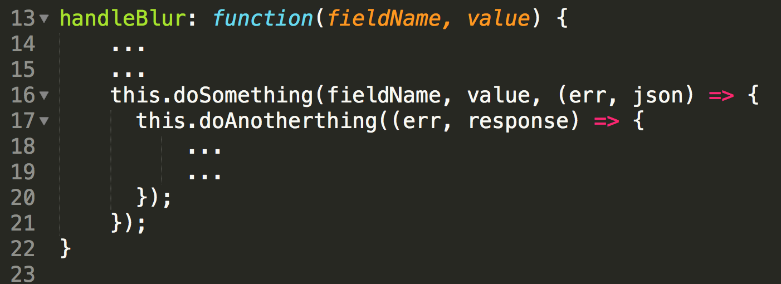
Syntax – arrow functions (this)
Source: alicoding

Slide 21
What’s new
Syntax
Libraries

Slide 22
Library – Numbers
Binary notation – 0b00001111 === 15
Octal notation – 0o17 === 15
Number.isInteger(number)
Number.isNaN(value)
Number.isFinite(number)
Number.isSafeInteger(number)
Number.EPSILON – Error margin (0.1+0.2 !== 0.3)

Slide 23
Library – Strings
String.repeat(count)
String.includes(string, index)
String.startsWith(string, index)
String.endsWith(string, index)
Template Strings
Multiline strings
Expressions
String interpolation
String tagging

Slide 24
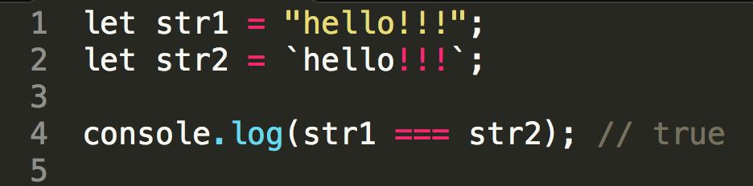
Library – Template Strings

Slide 25
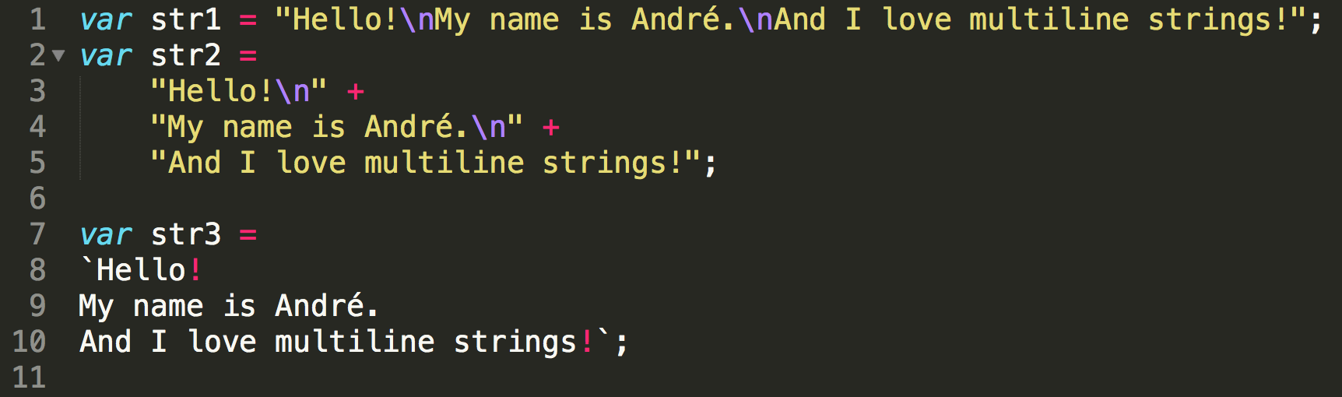
Library – Template Strings (multiline)

Slide 26
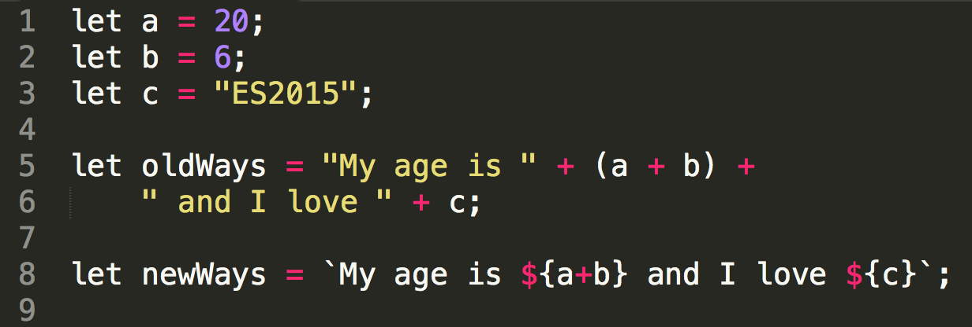
Library – Template Strings (expressions)

Slide 27
Library – Arrays
Array.from(iterable, mapFunc, this)
Array.of(values…)
Array.fill(value, startIndex, endIndex)
Array.find(testingFunc, this)
Array.findIndex(testingFunc, this)
Array.entries()
Array.keys()
Array.values()

Slide 28
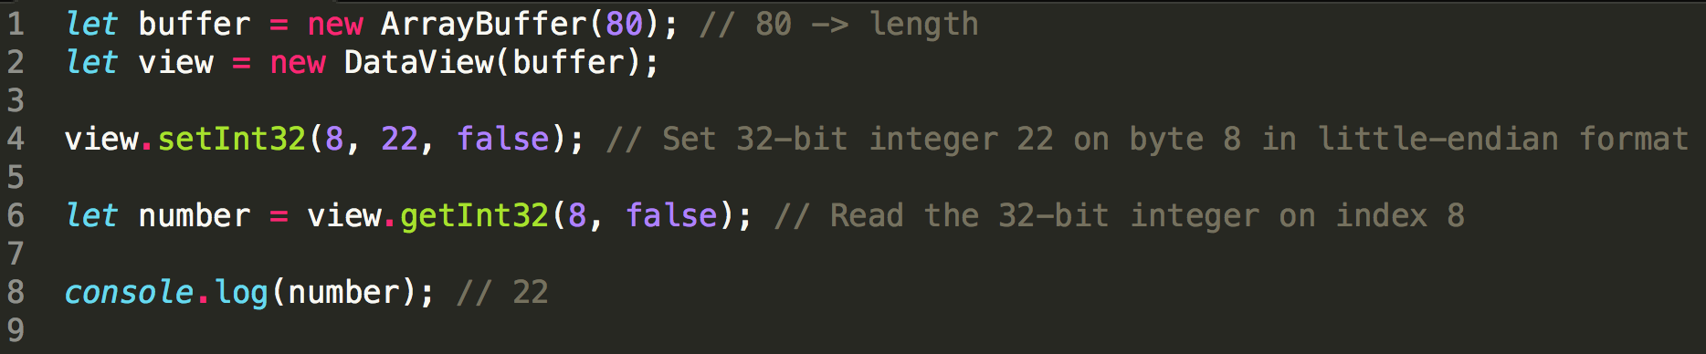
Library – Collections
Array Buffers
Super fast fixed-dimensions array-like collections of 8-bit blocks in memory
Can only store numbers, but the real geeky versions of numbers:
Int8; UInt8; Int16; UInt16; Int32; UInt32; Float32; Float64

Slide 29
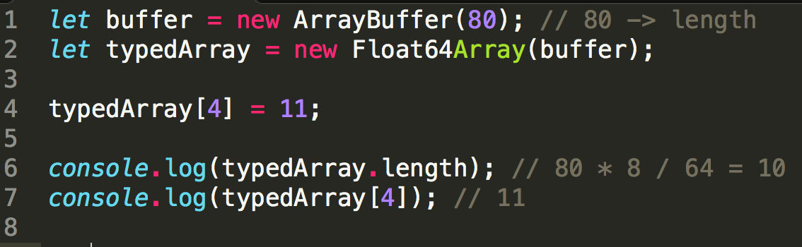
Library – Collections
Typed Arrays
Wrappers for the Array Buffers
Can read and write only one type of number:
Int8Array; UInt8Array; Int16Array; UInt16Array; Int32Array; UInt32Array; Float32Array; Float64Array

Slide 30
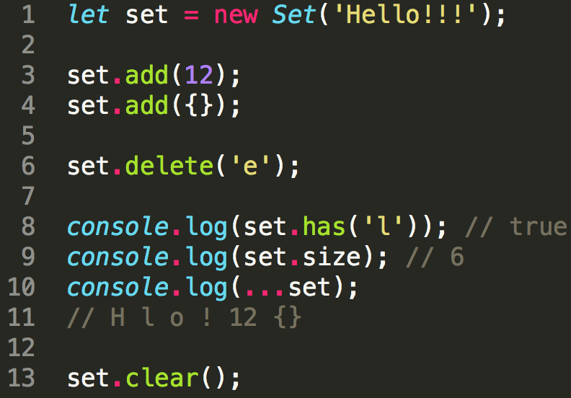
Library – Collections
Set
Collection of unique values of any data type, arranged in insertion order
WeakSet
Collection of unique object references
Does not implement the iterable protocol
Objects will be garbage collected if
there are no other references to them

Slide 31
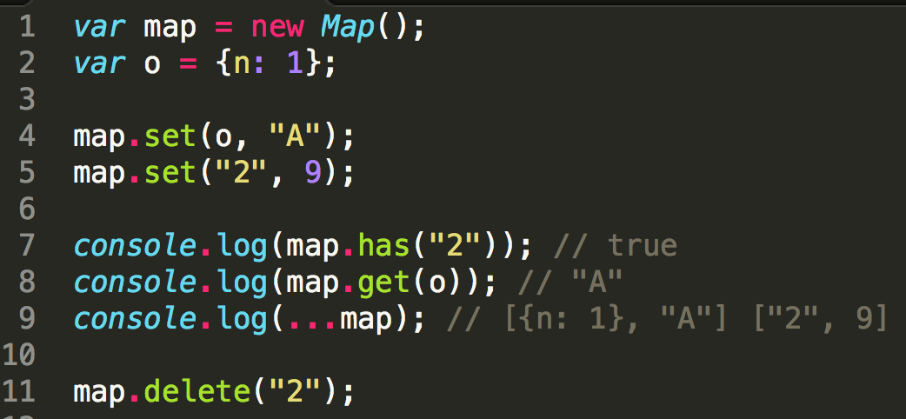
Library – Collections
Map
Collection of key/value pairs of any data type for both keys and values
WeakMap
Keys can only be object
references
Does not implement the
iterable protocol
Objects will be garbage
collected if there are no
other references to them

Slide 32
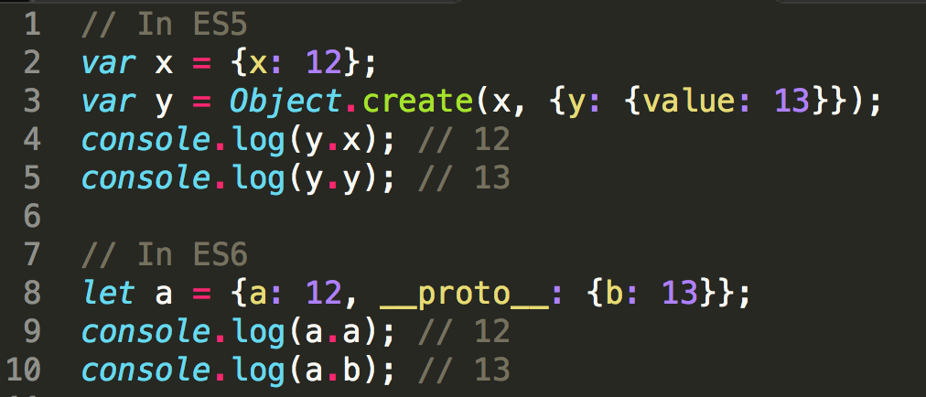
Library – Object
Long live the __proto__
Accessor property that exposes the internal [[prototype]] property
Same as what was already implemented in some browsers, but now standardized

Slide 33
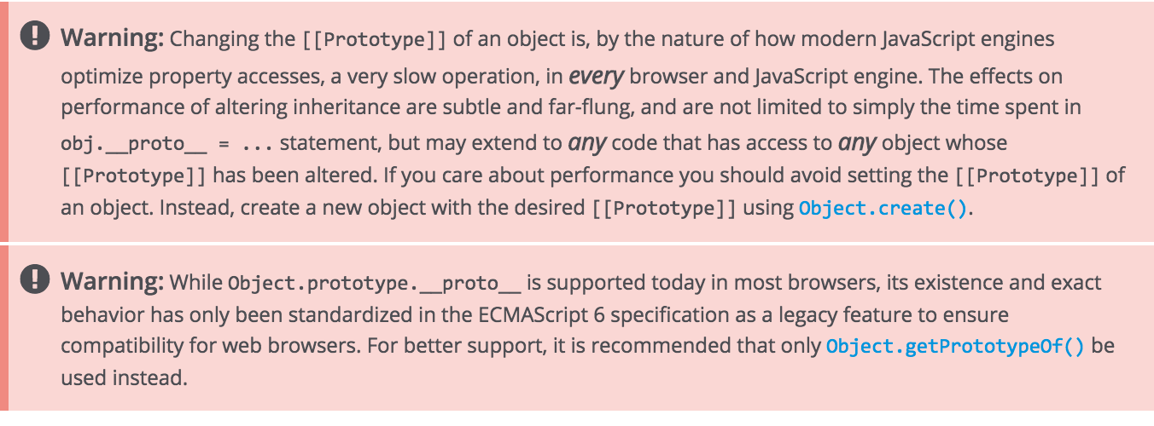
Library – Object
Long live the __proto__
Accessor property that exposes the internal [[prototype]] property
Same as what was already implemented in some browsers, but standardized now

Slide 34
Library – Object
Object.is(value1, value2)
Similar to === but NaN is NaN
Object.setPrototypeOf(object, prototype)
Same as __proto__ but the recommended version
We already had a Object.getPrototypeOf in ES5.1
Object.assign(targetObj, sourceObjs…)
Copy the values of all enumerable own properties from one or more source objects to a target object

Slide 35
What’s new
Syntax
Libraries
Iterators

Slide 36
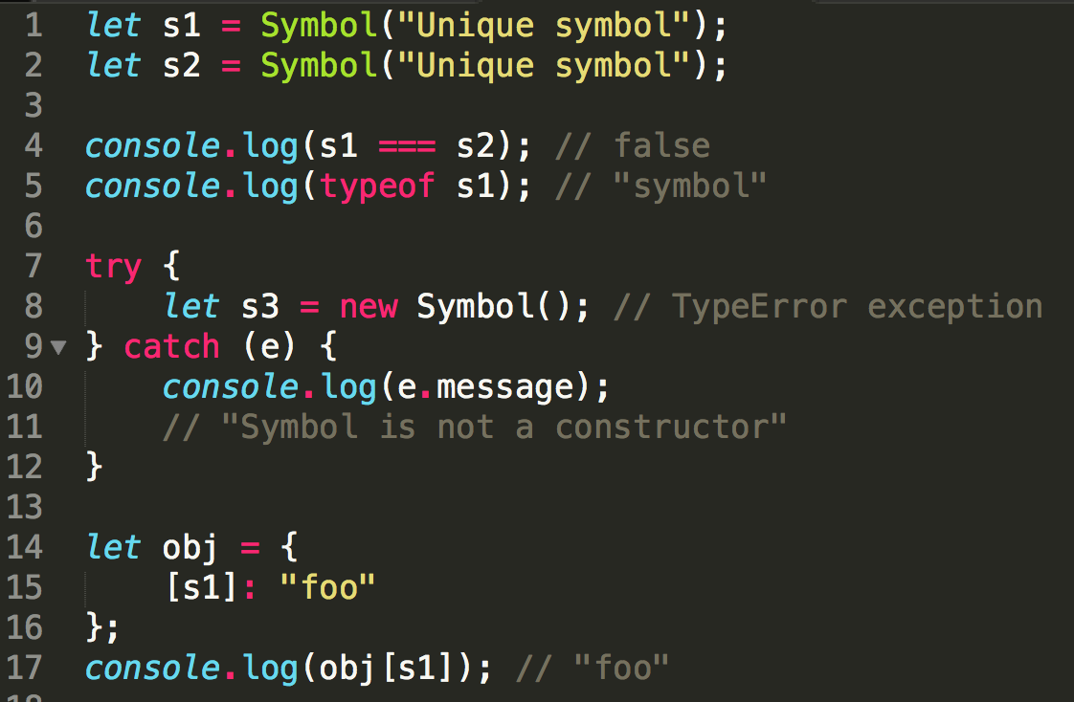
Iterators – Symbols
New primitive type
Unique and immutable
No literal form – we need to use Symbol() function
Can be used as property keys

Slide 37
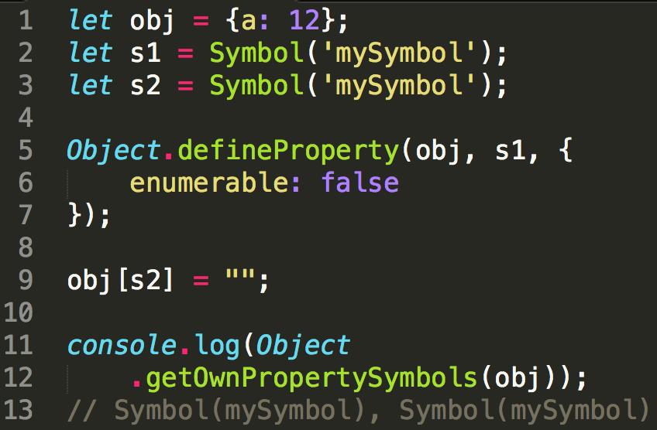
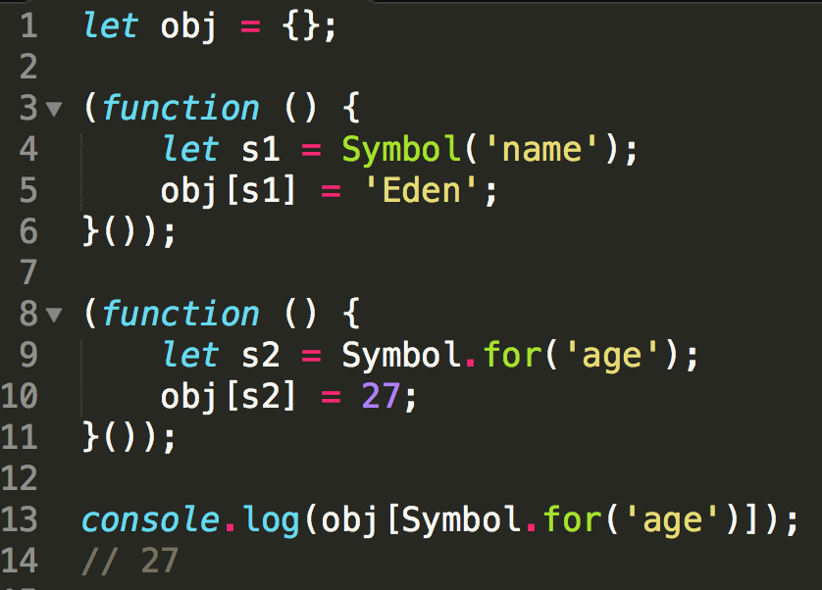
Iterators – Symbols
Object.getOwnPropertySymbols()
Symbol.for(string)

Slide 38
Iterators – Well-known Symbols
Symbol.iterator => @@iterator
Symbol.match => @@match
Symbol.search => @@search
Symbol.replace => @@replace
Symbol.split => @@split
Symbol.hasInstance => @@hasInstance
Symbol.species => @@species
Symbol.unscopables => @@unscopables
Symbol.isConcatSpreadable => @@isConcatSpreadable
Symbol.toPrimitive => @@toPrimitive
Symbol.toStringTag => @@toStringTag

Slide 39
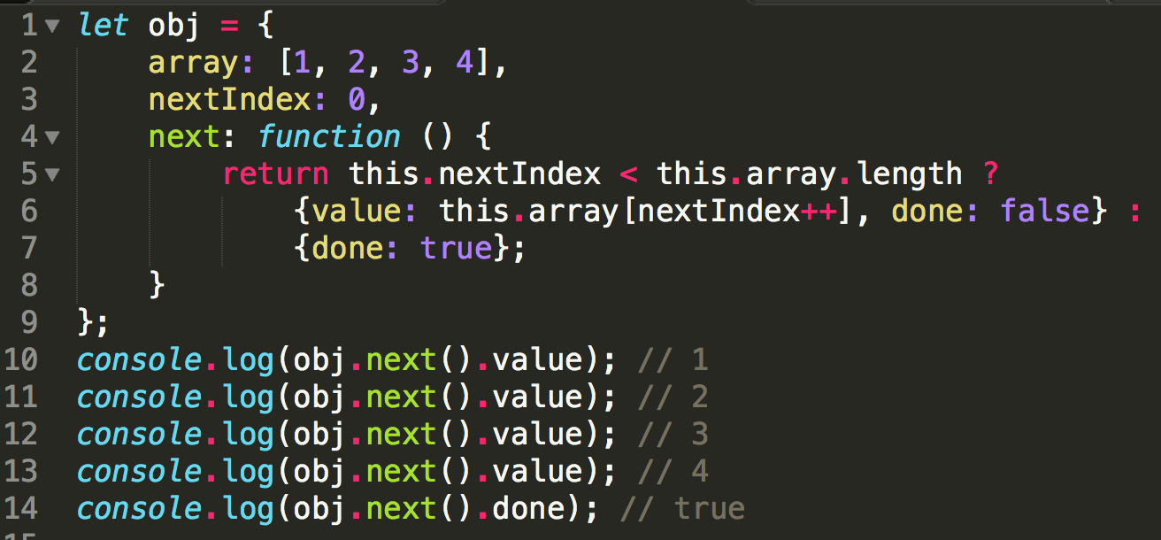
Iterators – The iterator protocol
Set of rules that an object needs to follow for implementing the interface, which when used, a loop or a construct can iterate over a group of values of the object.

Slide 40
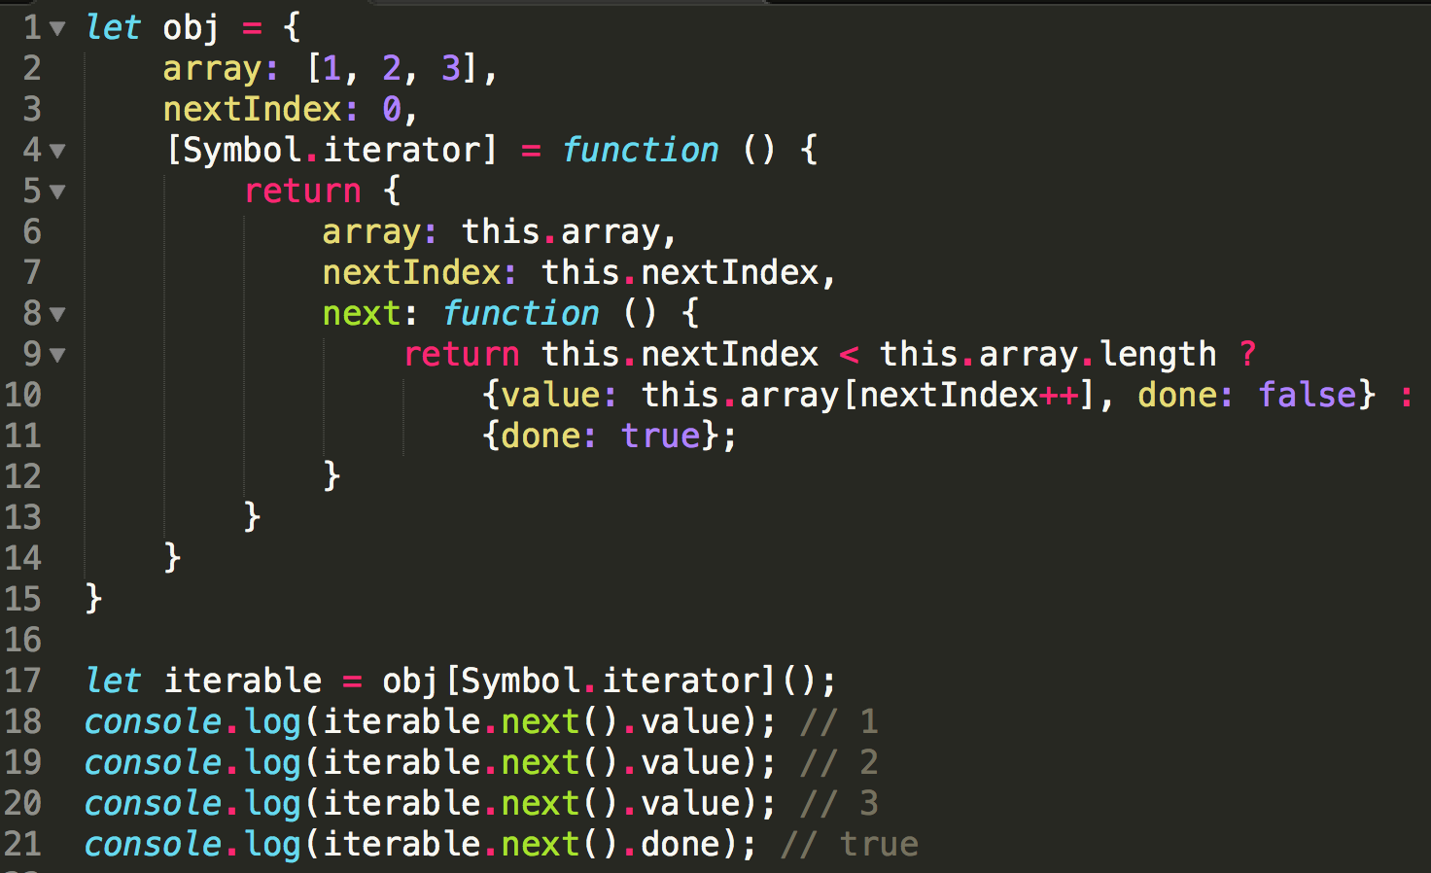
Iterators – The iterable protocol
Any object that implements the iterable protocol is an iterable
That object needs to provide the @@iterator method implementing the iterator protocol

Slide 41
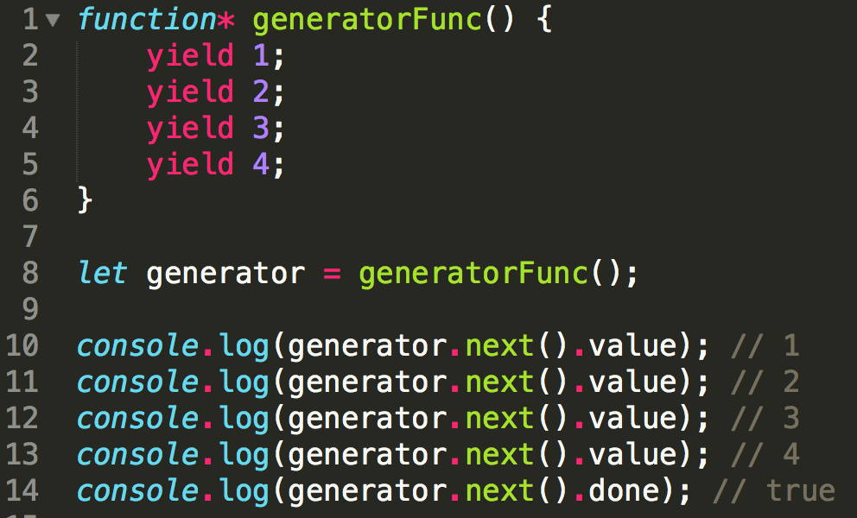
Generators – The iterator factory
Unlike a function, doesn’t execute its body immediately
Returns an instance implementing the iterator protocol
Calling next() will execute the body until it finds the ‘yield’ keyword
The ‘yielded’ value is returned in the next().value
Further calls to next() will resume execution until the next ‘yield’
When the execution ends, next().done will be true

Slide 42
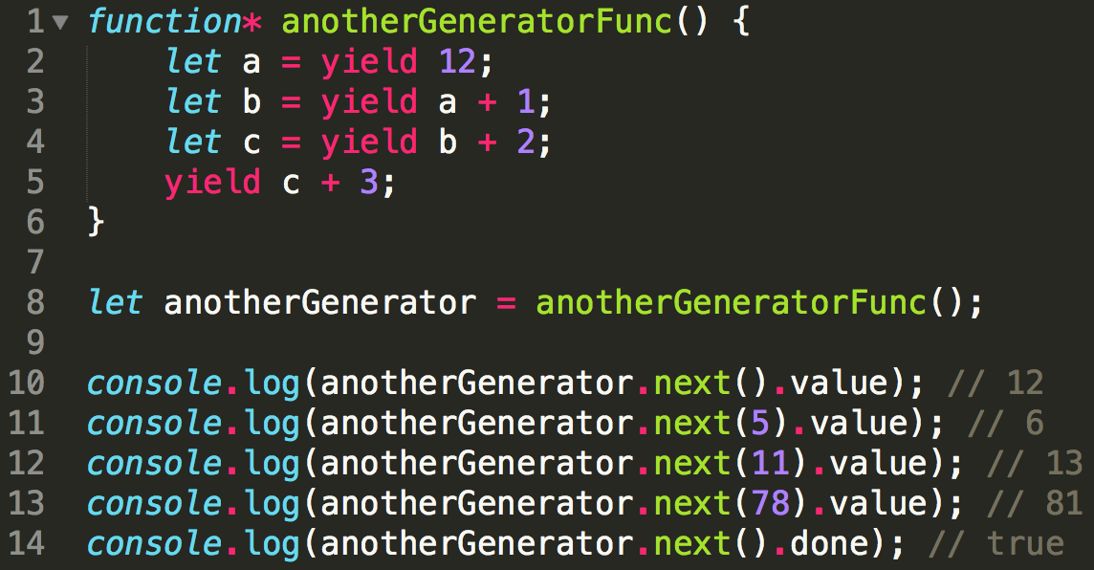
Generators – The iterator factory
By using the optional argument of next() we can change the internal state of the generator

Slide 43
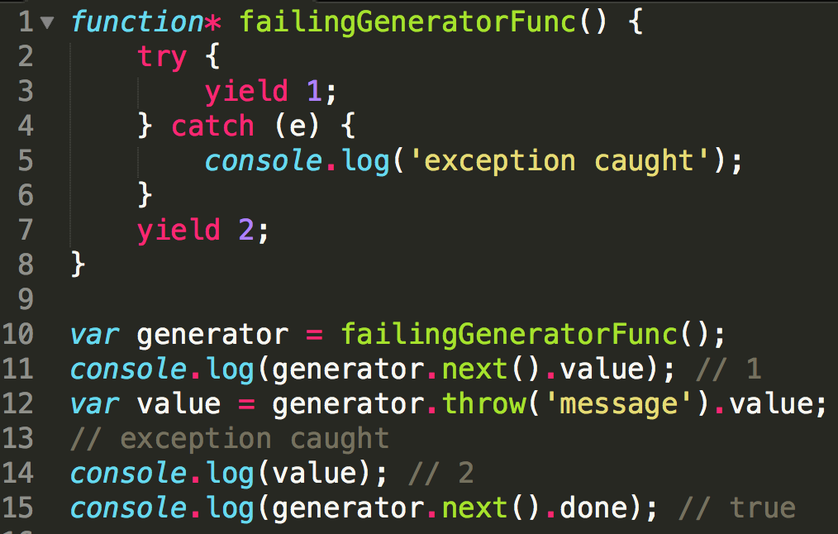
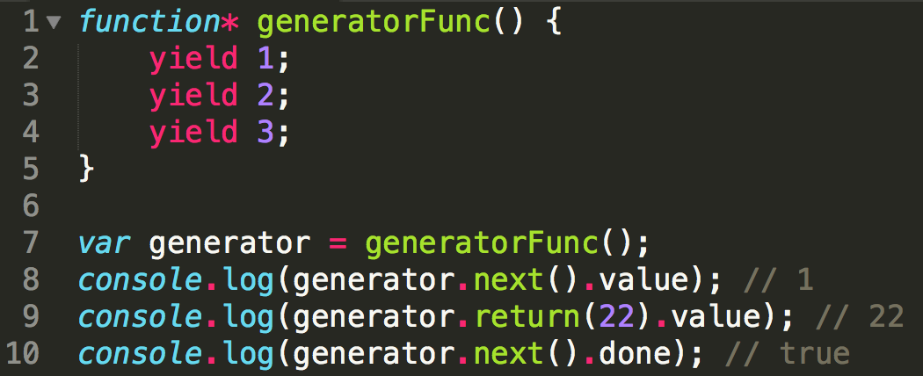
Generators – The iterator factory
You can anytime end a generator function before it has yielded all the values using return()
Or manually trigger exceptions from outside the generator

Slide 44
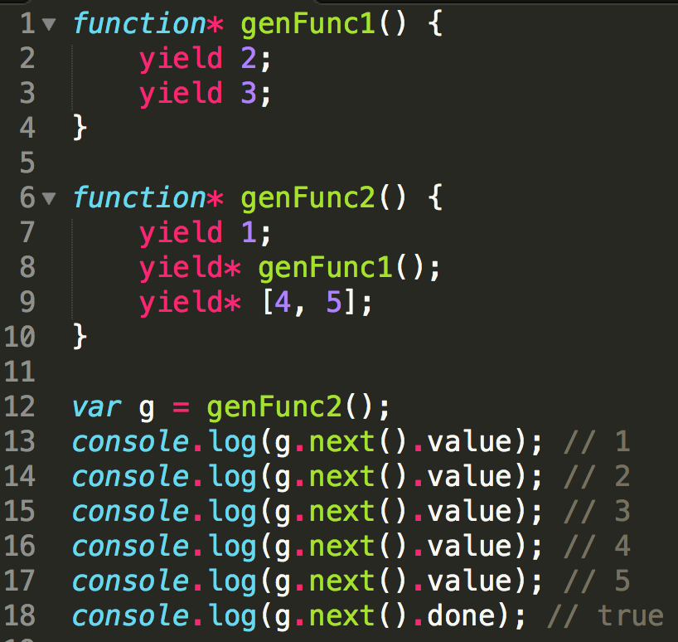
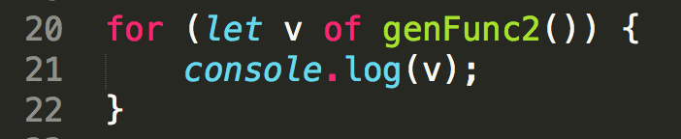
Generators – The iterator factory
Last but not least, you can also yield other iterables (including generators) inside a generator
And start using “for … of” with any iterables, including generators, arrays, or anything you build implemeting the iterable protocol!

Slide 45
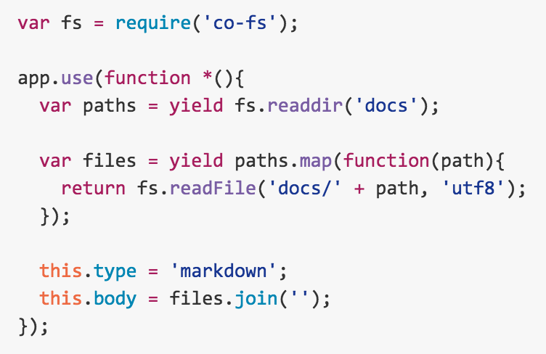
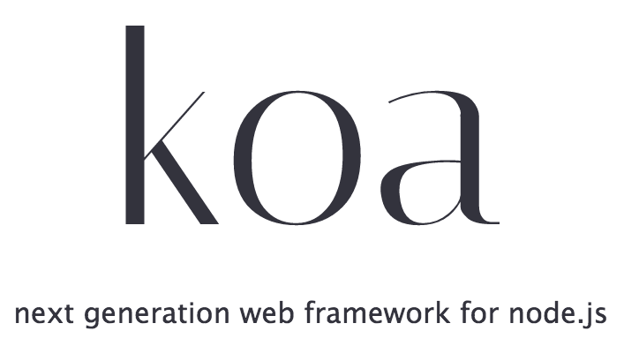
Learn more about the magic of generators
(or just wait to hear about the upcoming async/await in ES7, but that’s for another talk)

Slide 46
What’s new
Syntax
Libraries
Iterators
Promises

Slide 47
Promises
The Promise object is used for deferred and asynchronous computations. A Promise represents an operation that hasn't completed yet, but is expected in the future.
Promise.resolve(value)
Promise.reject(reason)
Promise.race(iterable)
Promise.all(iterable)
Promise.prototype.then(onFulfilled, onRejected)
Promise.prototype.catch(onRejected)

Slide 48
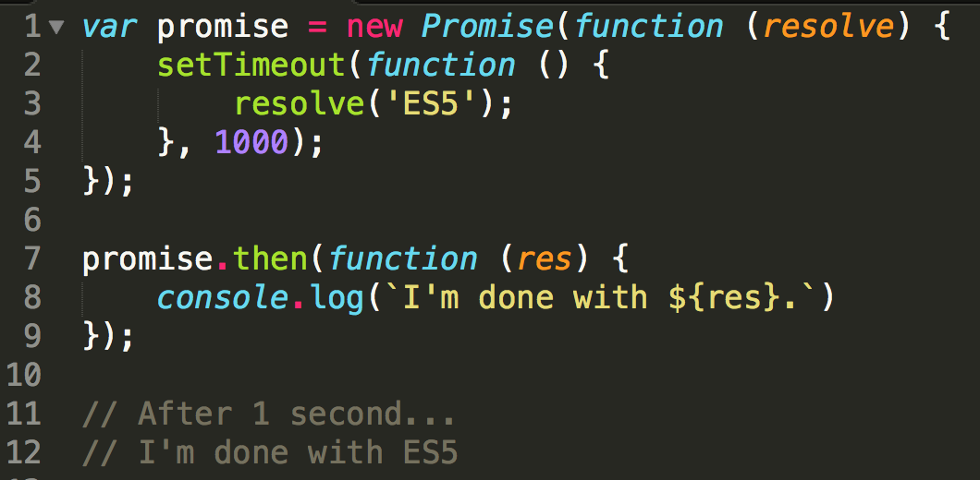
Promises

Slide 49
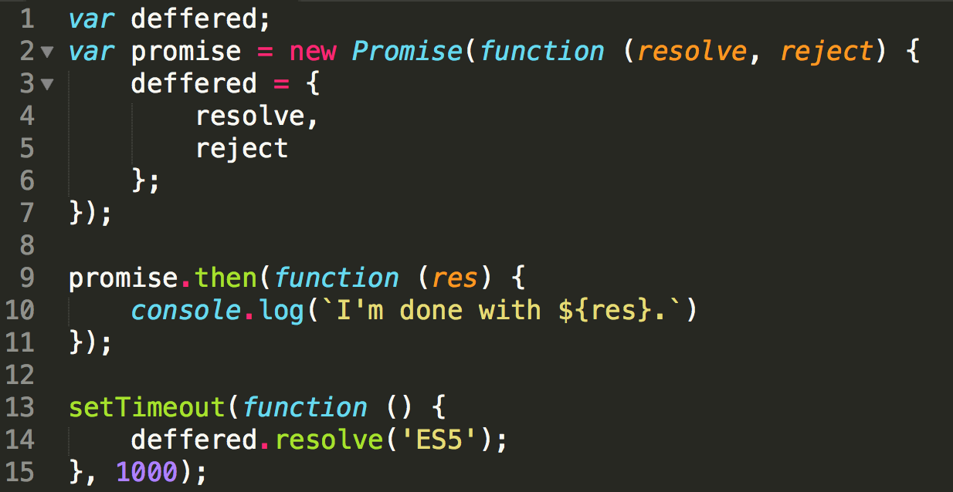
Promises – do you miss $q’s deffered?

Slide 50
What’s new
Syntax
Libraries
Iterators
Promises
Classes

Slide 51
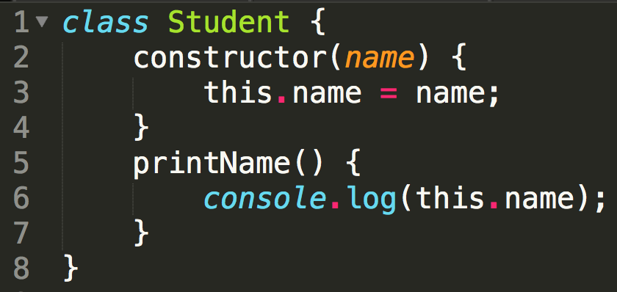
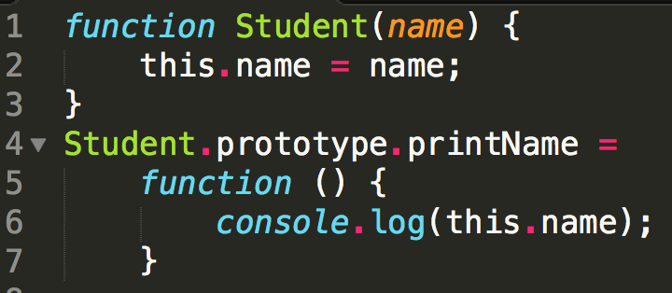
Classes – properties & methods

Slide 52
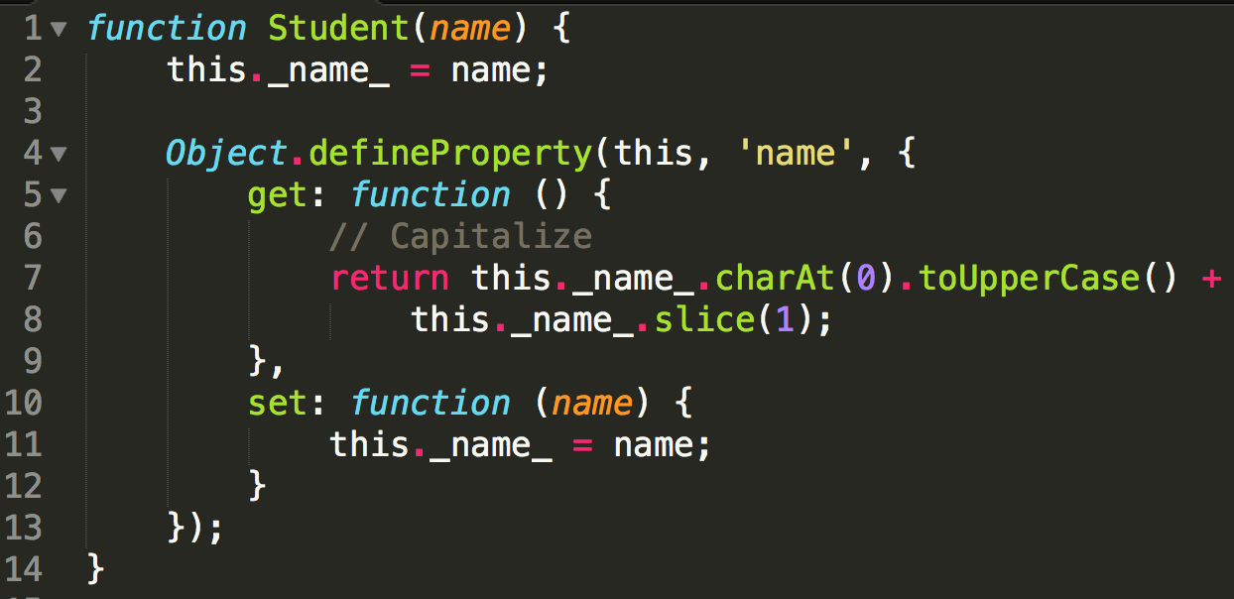
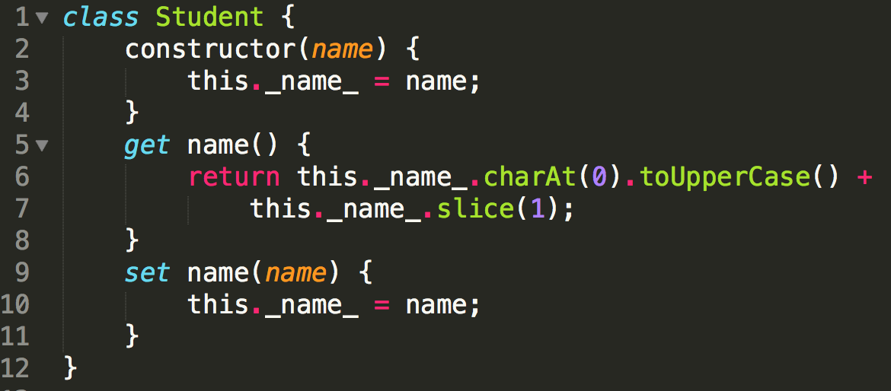
Classes – get & set methods

Slide 53
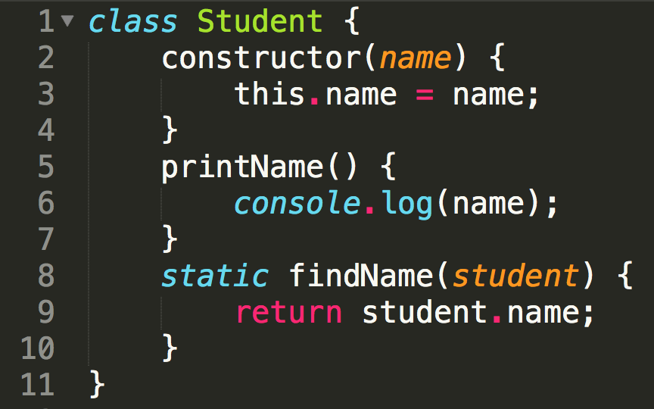
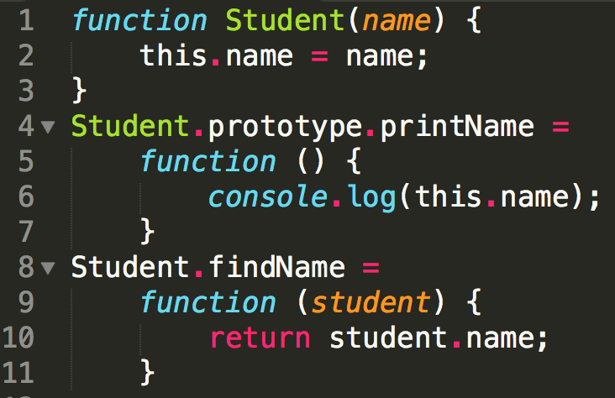
Classes – static methods

Slide 54


Classes – inheritance

Slide 55
What’s new
Syntax
Libraries
Iterators
Promises
Classes
Modules

Slide 56



Modules

Slide 57
What’s new
Syntax
Libraries
Iterators
Promises
Classes
Modules
Out of scope
Reflect API
Proxies

Slide 59
Thanks!
Send questions to andre.duarte@blip.pt
or @onemanclapping
or just get up and ask!
Slides available at http://andreduarte.info

